Slide 1
Mapping the spatial distribution of urban traffic congestion: methodological exploration using web based services
Cohen, Jonathan¹
Gil, Jorge¹
¹ Chalmers University of Technology, Sweden
November 2020

Slide 2
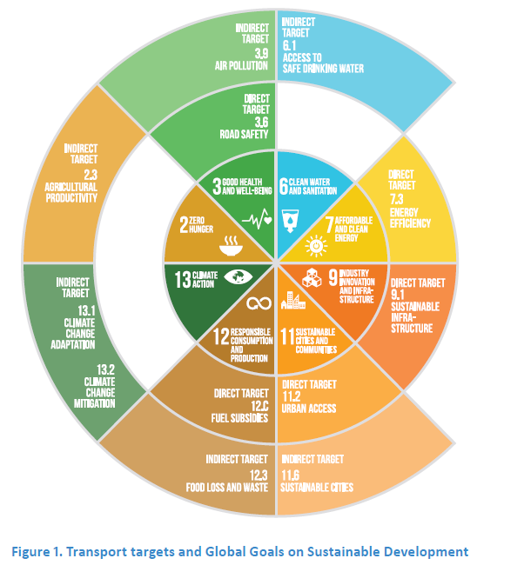
Role of mobility to achieve SDGs
Transport systems are important to achieve several SDGs.
Direct relation to targets: 3.6, 7.3, 9.1, 11.2
Indirect relation to targets: 2.3, 3.9, 6.1, 11.6, 12.3, 13.1 & 13.2
Booth, Hanmer, and Lovell (2000). SLoCaT (2015)
Notes:
One of the main characteristics that makes cities successful is that these are places of intense human interactions.
Sustainable and resilient transport systems are a requirement to achieve several of the SD targets
There is a long tradition of the study of congestion, but there is no universal definition of what it is?

Slide 3
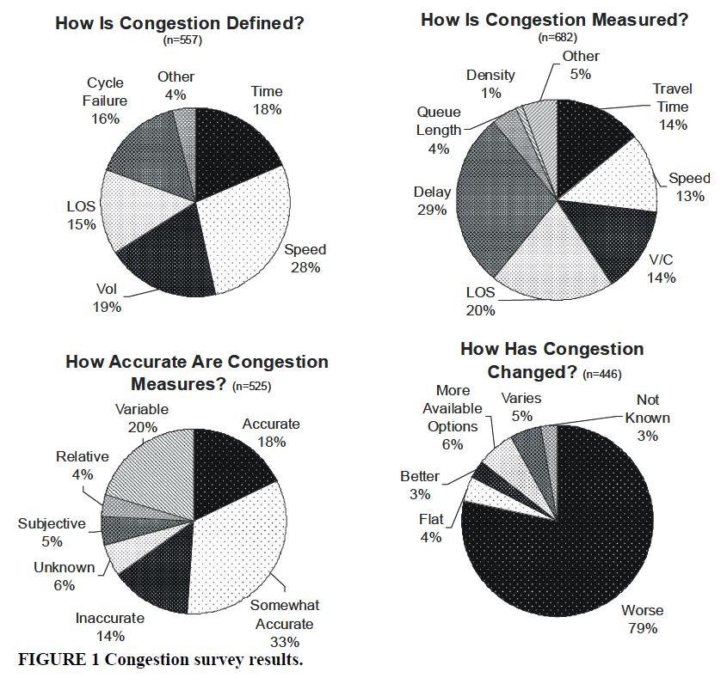
The problem of congestion
Time, speed, LOS and many other variables are used to define congestion.
Congestion can be measured in a variety of ways
18% think that the measures are accurate (33% somewhat accurate).
80% of transportation professionals believe that congestion problems has worsen.
Bertini, Robert L. (2005).
Notes:
This generates a diverse way of measuring and make experts unsure of its accuracy.
What is worst is that 80% of mobility practitioners think that the problem of congestion has became worse

Slide 4
Congestion costs
As a result of congestion, travel time, energy consumption and environmental cost will continue rising
Conservative estimates indicate that for every 1km/h increase in private cars and by 0.5 km/h are worth 0.1% of the Gross Domestic Product (GDP)
Social costs such as health related issues
Bull 2004; Diakaki, Kotsialos, and Wang (2003)
Thomson (2000)
Notes:
As the costs of congestions continue rising, it erodes the quality of urban life by increasing travel time, pollution and energy consumption
Congestion is also associated with other issues such as mental health, which are difficult to measure.
--> The problem is old, but still research is needed.
--> Luckily digitalization open new opportunities to study the problem with different perspective, tools and inputs.

Slide 5
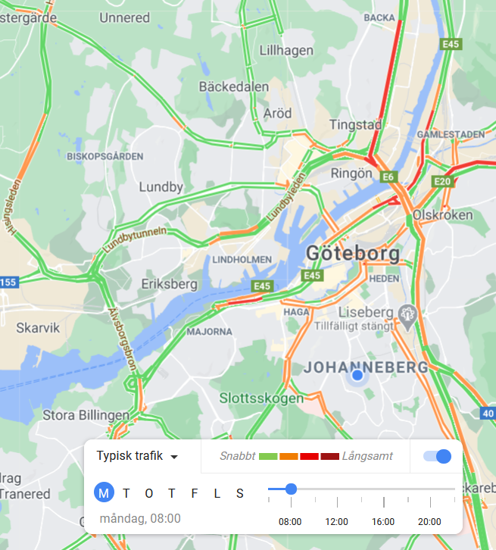
Objective
The aim of this research is to provide a reproducible methodology to measure how the problem of congestion is distributed across an urban area.
A new map of congestion can provide useful information to local authorities and planners to assess the impact on residents.
Notes:
We propose another way of looking at congestion by trying to link the citizens that are being affected

Slide 6
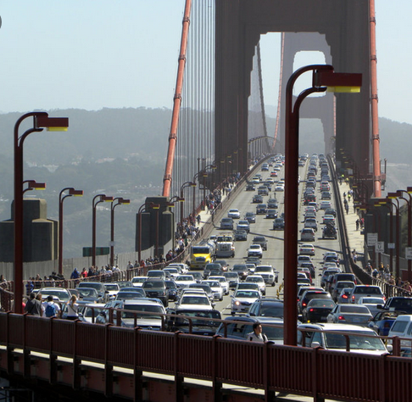
Objective
The aim of this research is to provide a reproducible methodology to measure how the problem of congestion is distributed across an urban area.
A new map of congestion can provide useful information to local authorities and planners to assess the impact on residents.
Where does this citizen live?

Slide 7
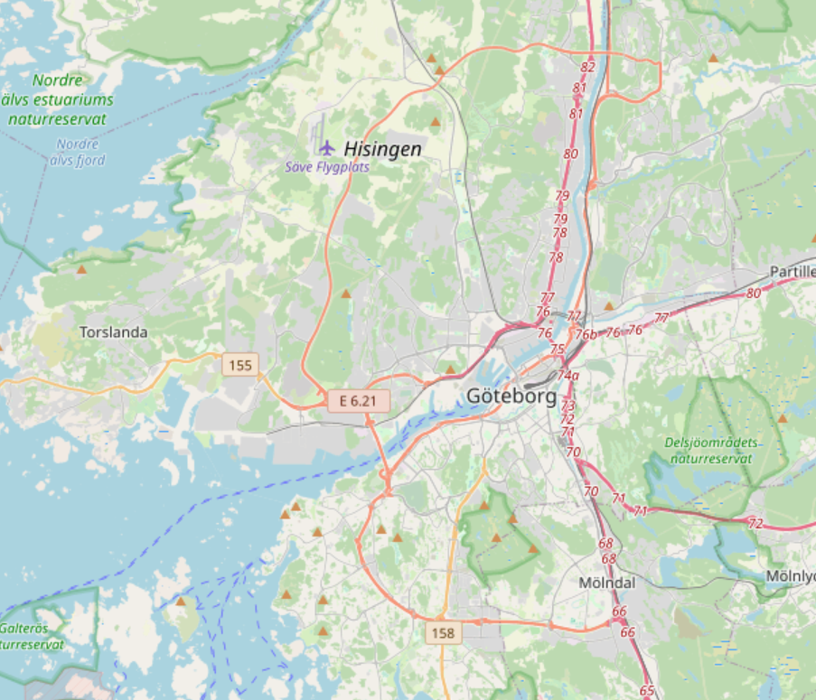
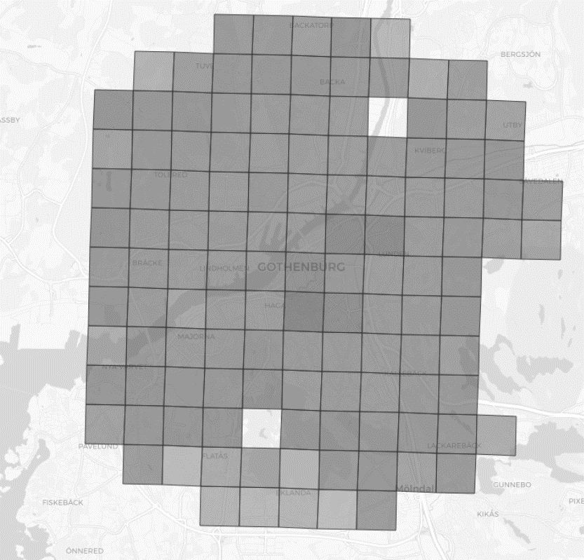
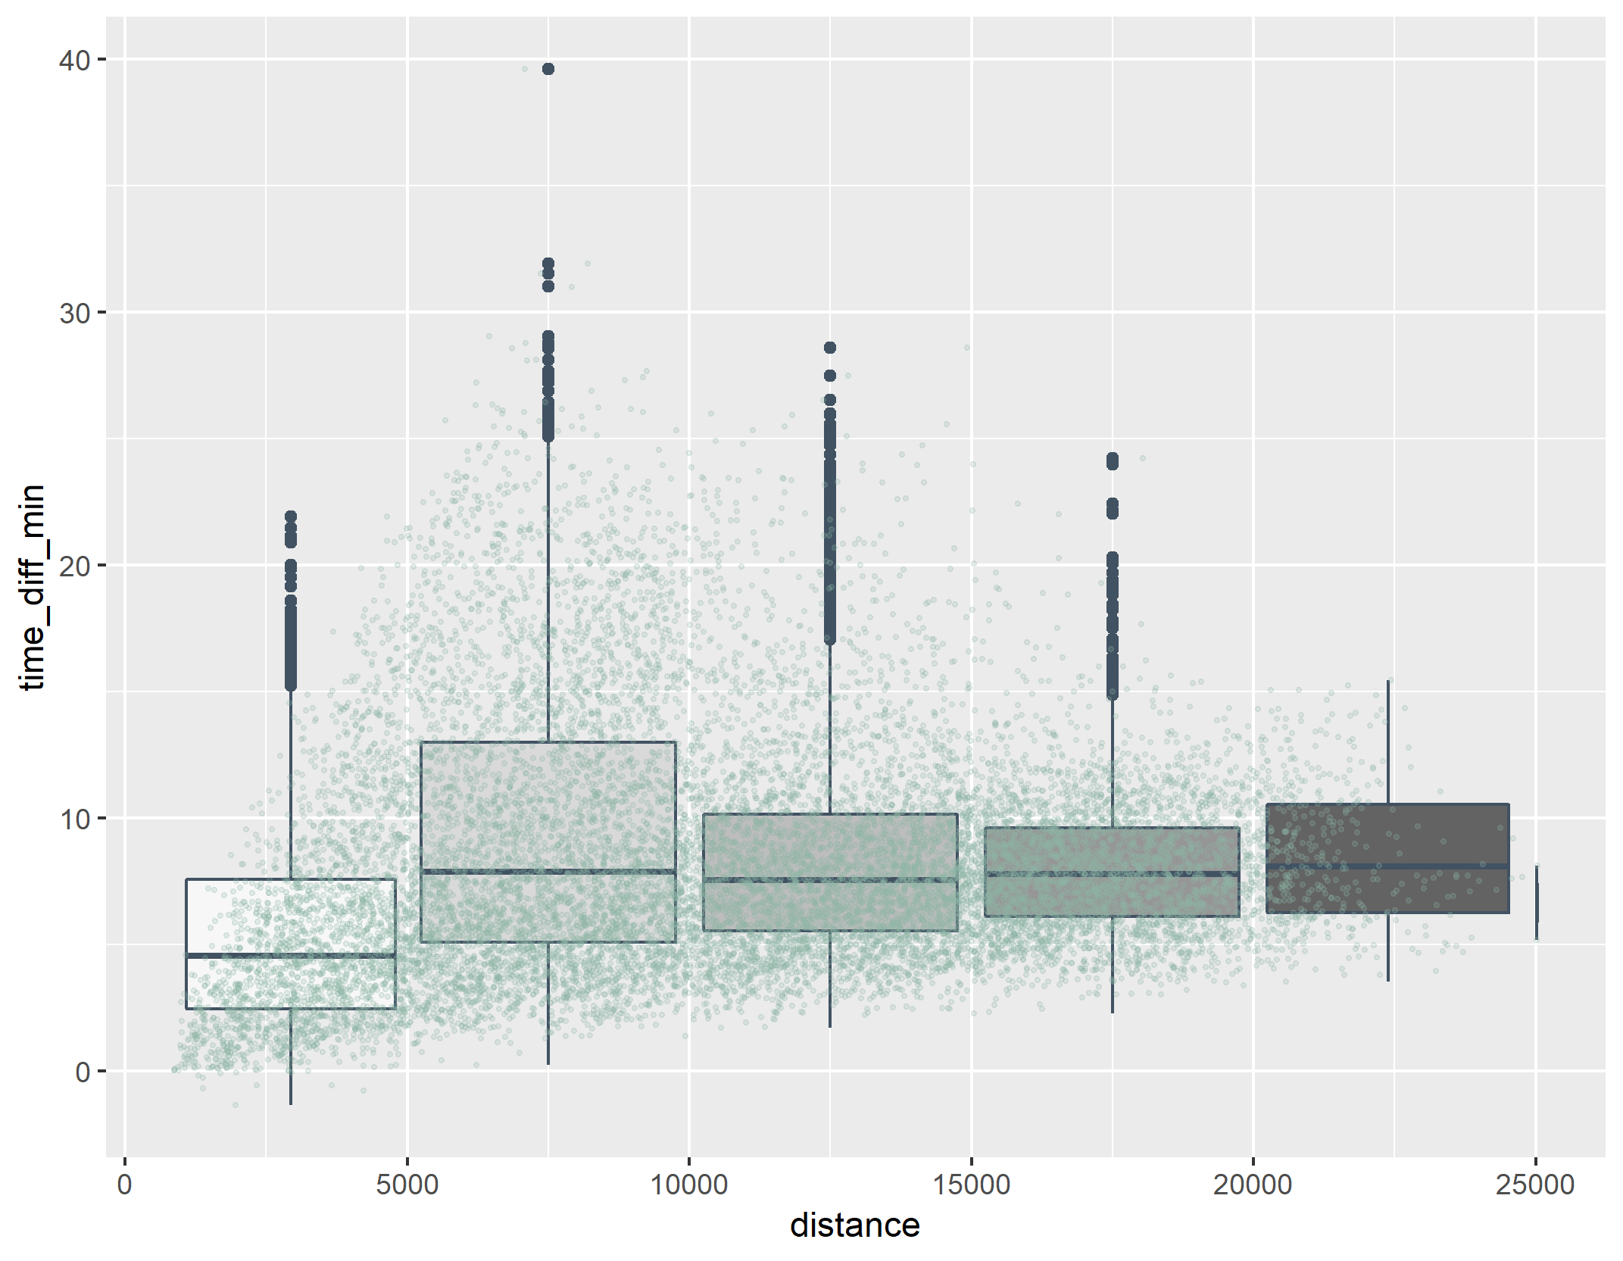

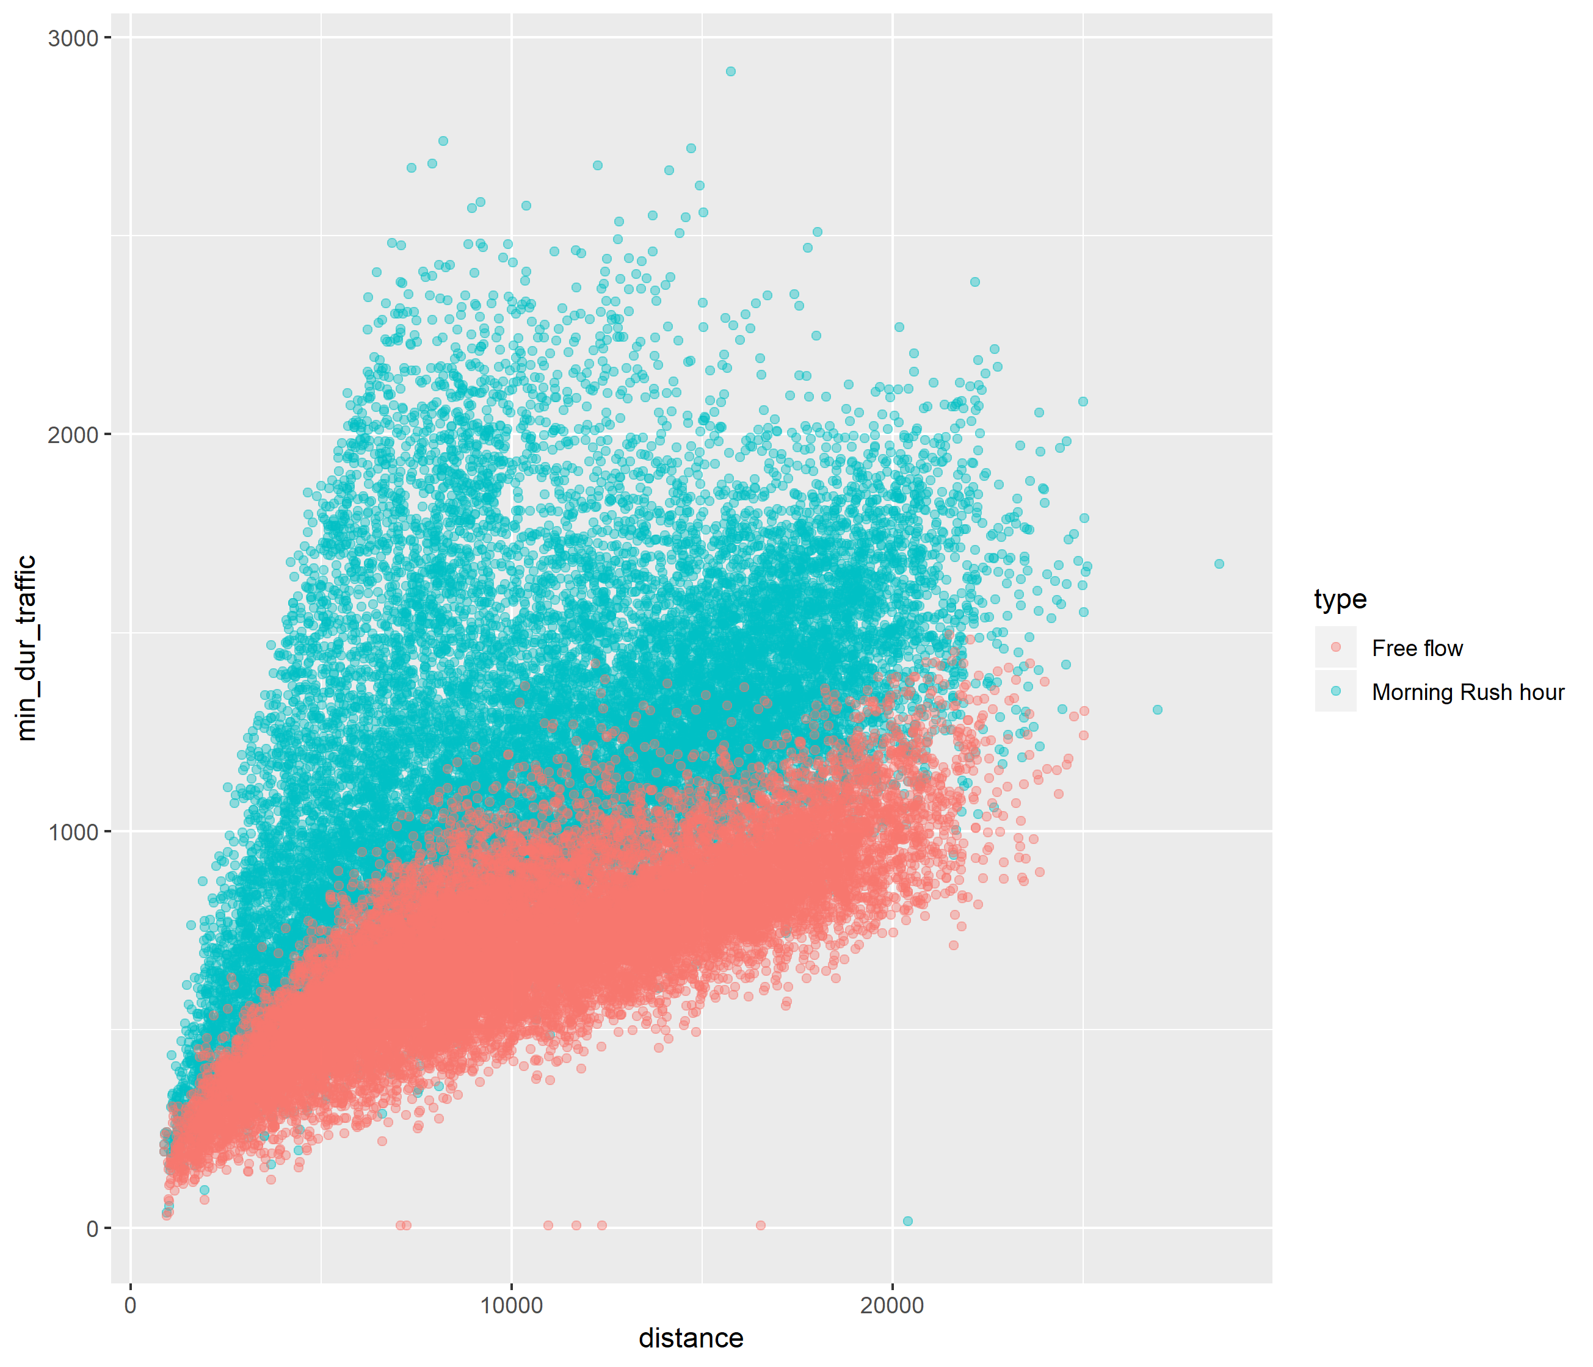
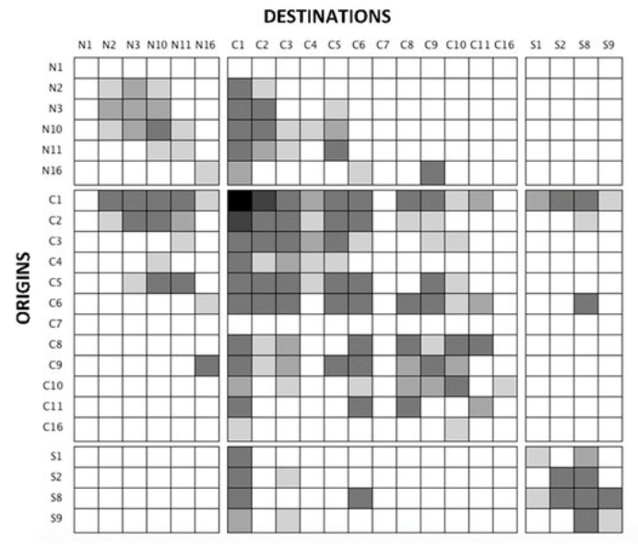
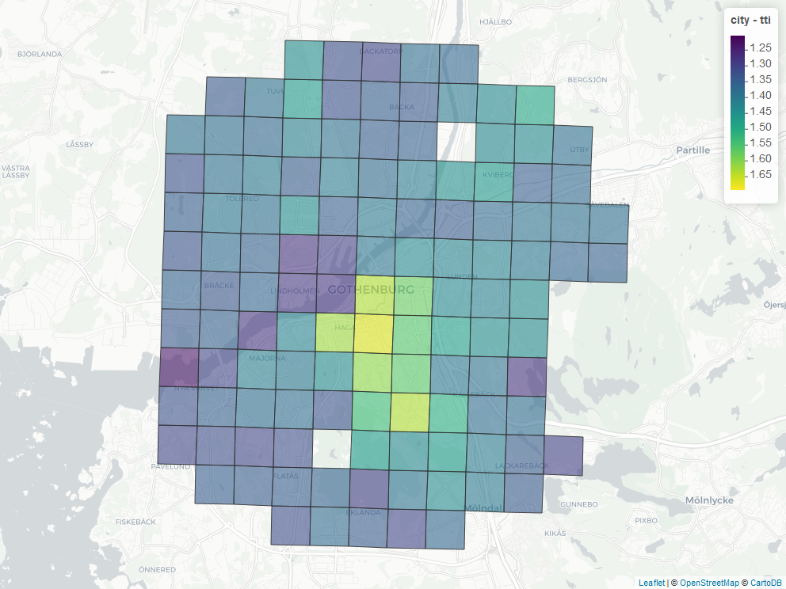
Methodology
Define study area & sub-divide it
Create list of all potential trips
Extract travel time and distances
Process data captured
Calculate KPIs and visualizations
Time difference
Relative time
GEOSTAT-grid-POP-1K-2011-V2-0-1.zip
TTI
Congested
vs
Non-congested
100 zones
100*100 trips
2*(100*100) trips
20,000 trips

Slide 8
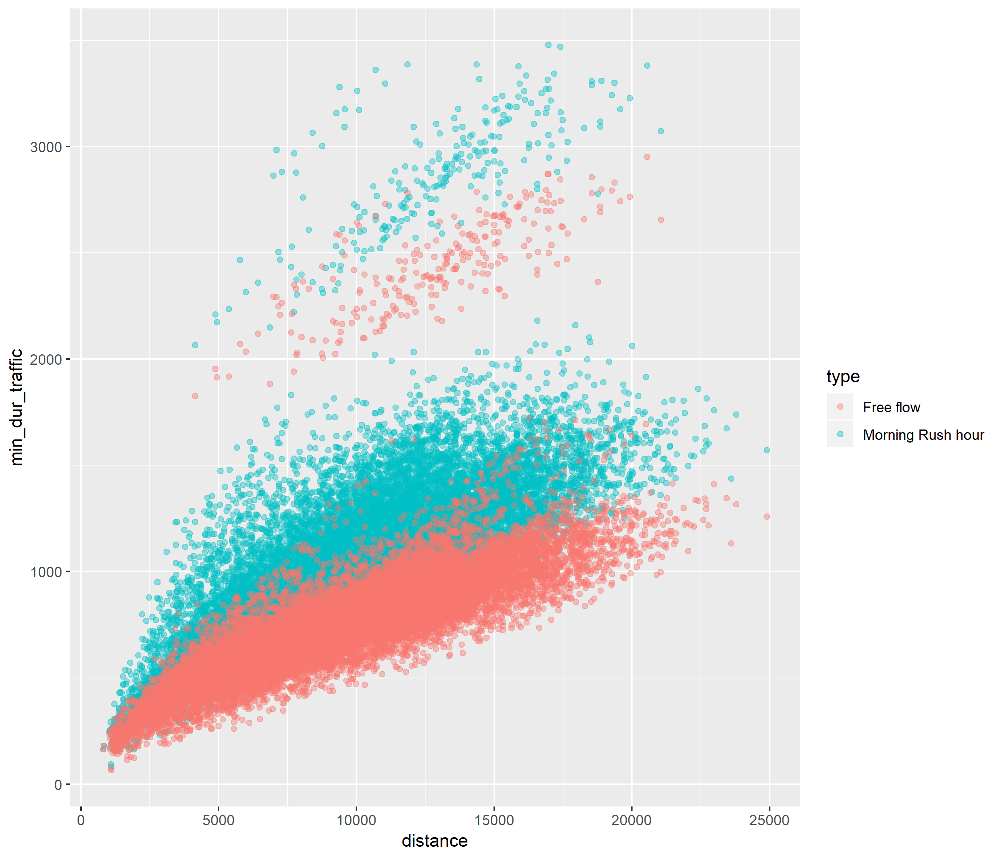
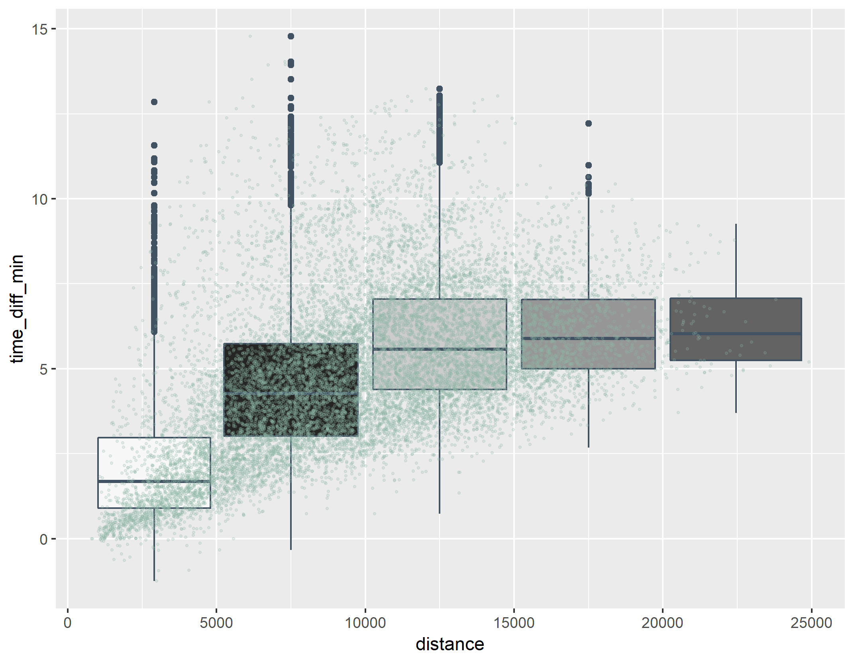
Results: Göteborg
Extract travel time and distances
Process data captured
130 zones
130*129 trips
2*(130*129) trips
35,000 trips

Slide 9
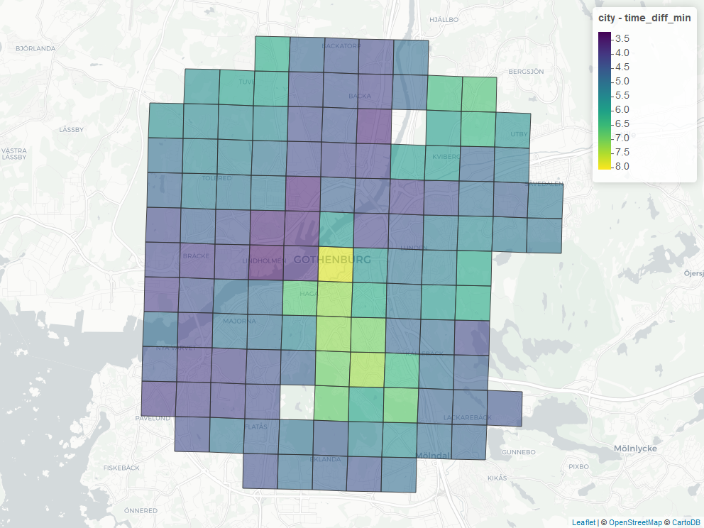
Results: Göteborg
Calculate KPIs and visualizations
Time difference
TTI
Time difference = Average (Congested time – NonCongested time)
TTI = Average (Congested time / NonCongested time)

Slide 10
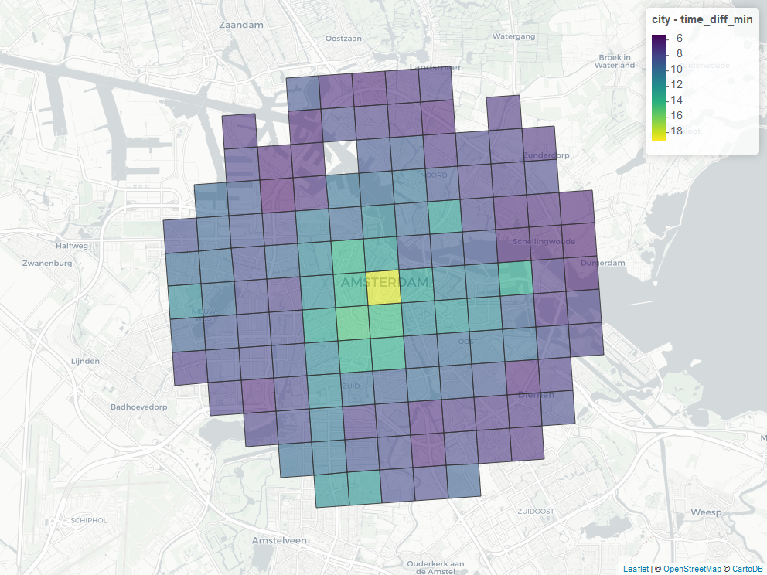
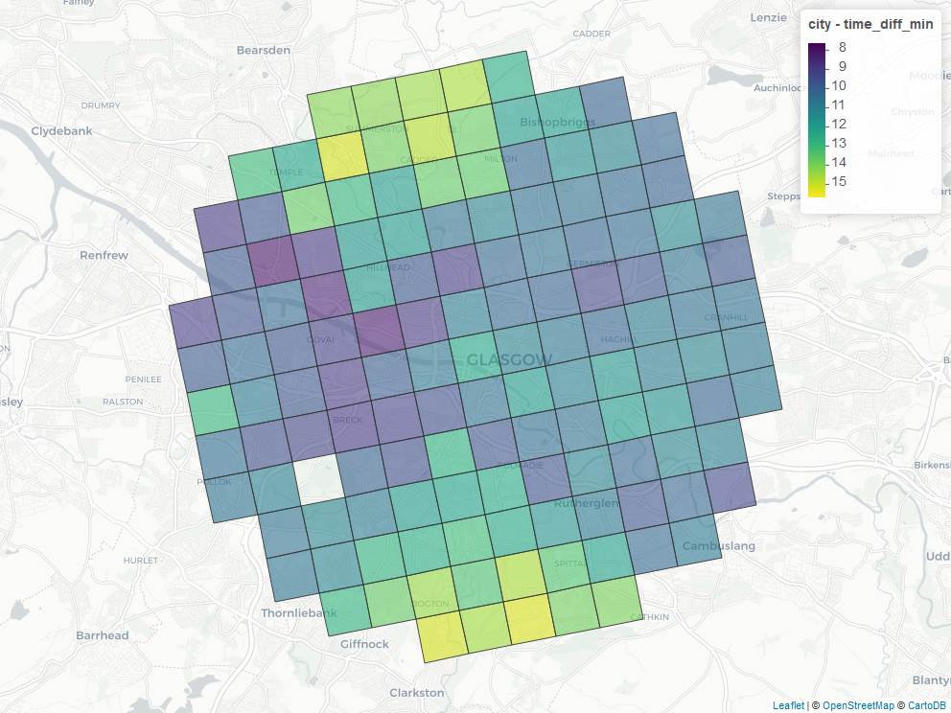
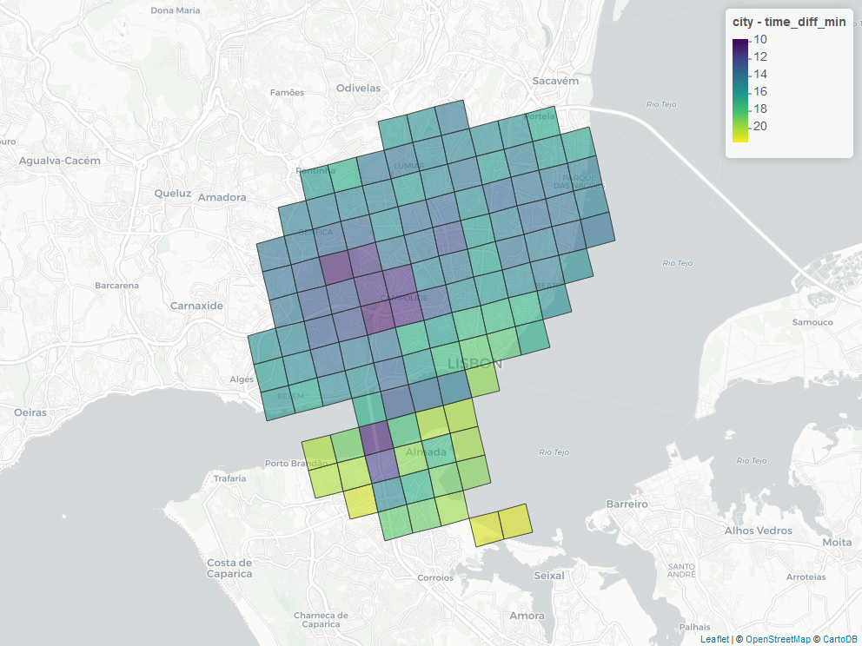
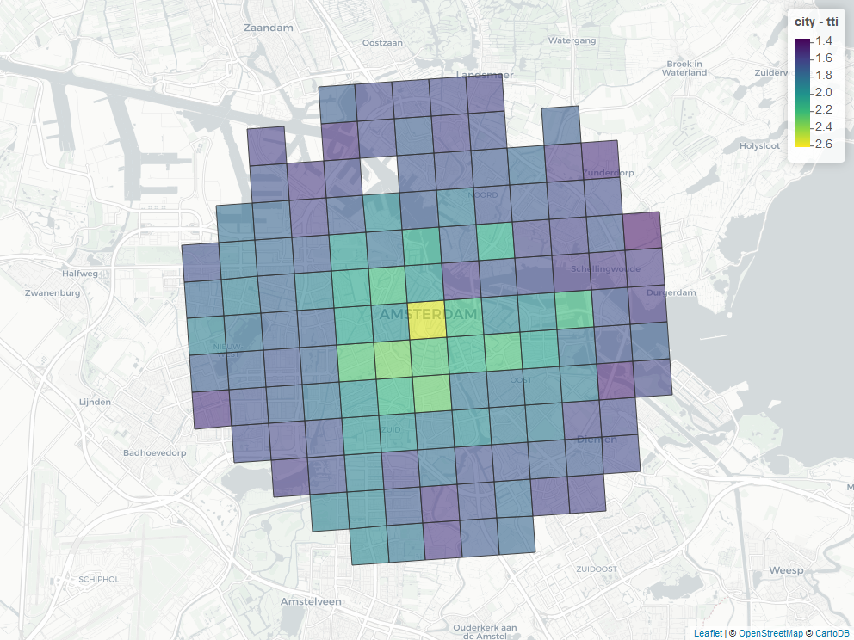
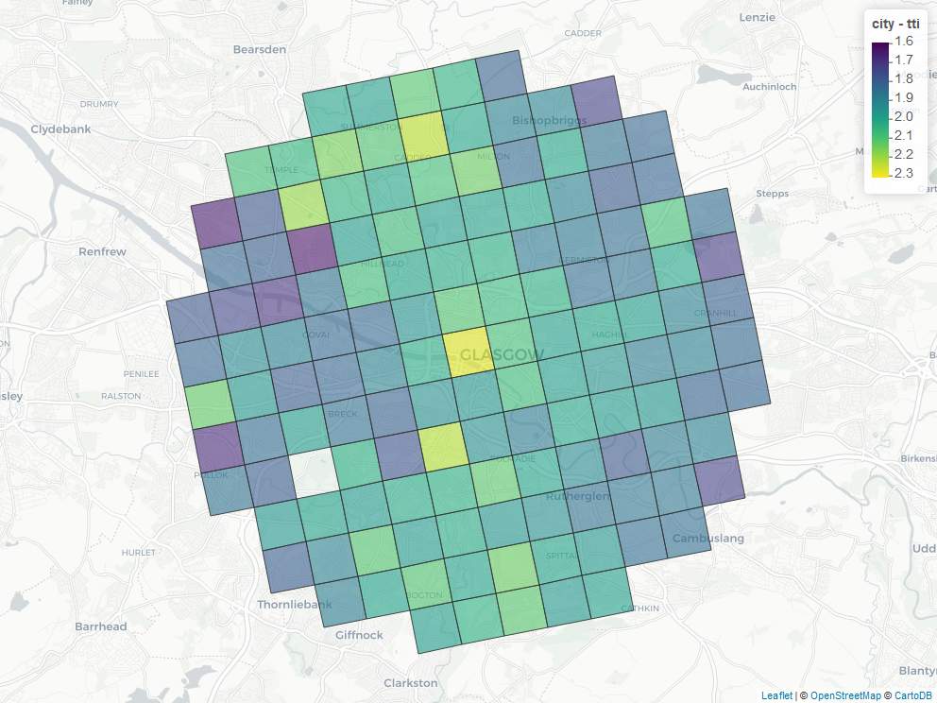
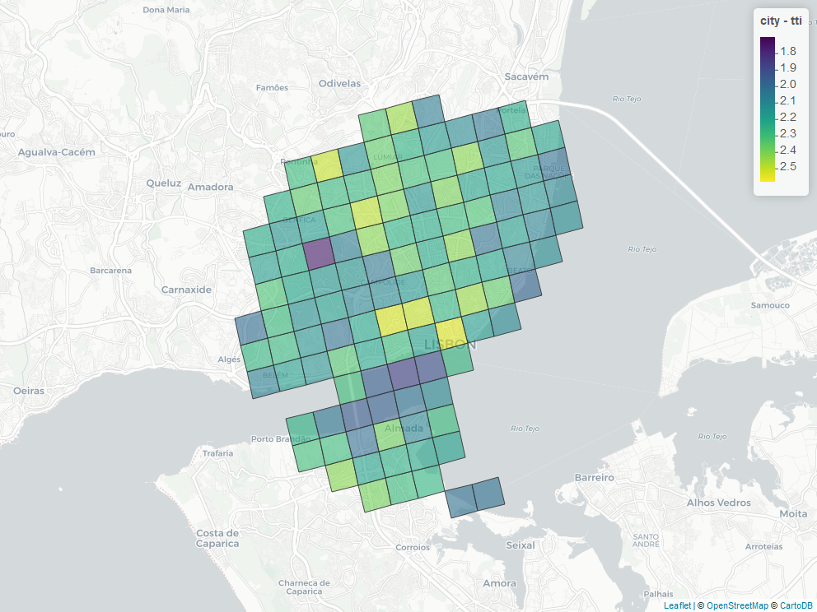
Results: multiple city profiles
AMSTERDAM
GLASGOW
GOTEBORG
LISBON
Time difference
TTI
Notes:
The bigger the badder

Slide 11
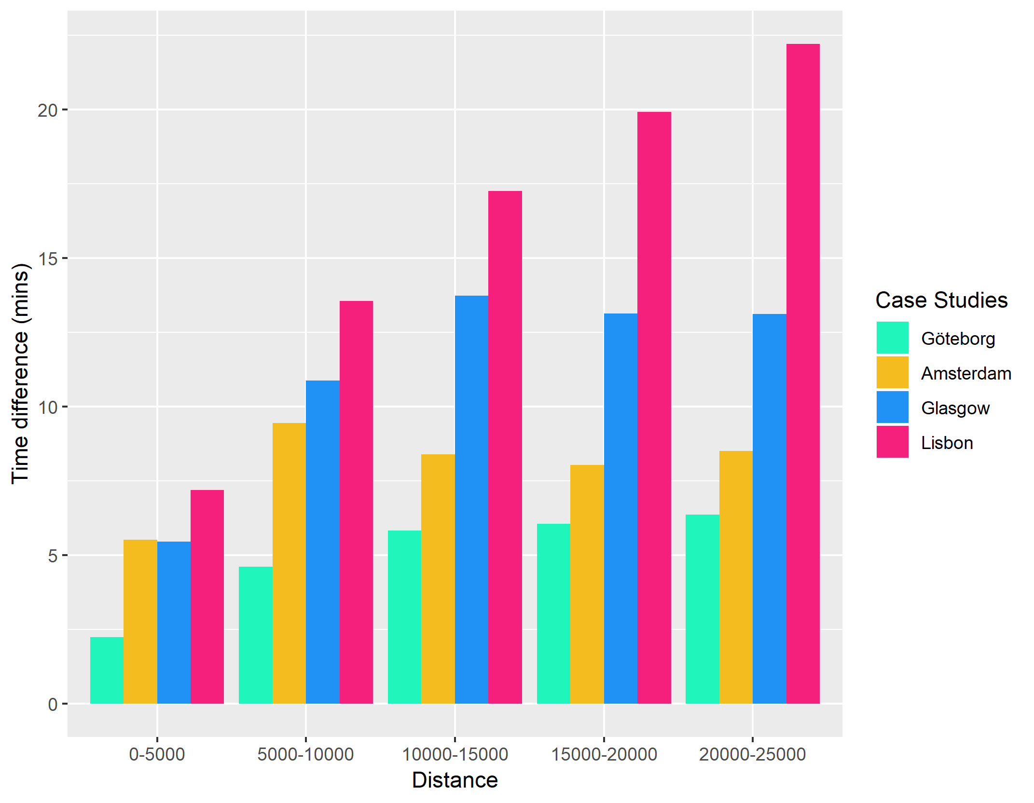
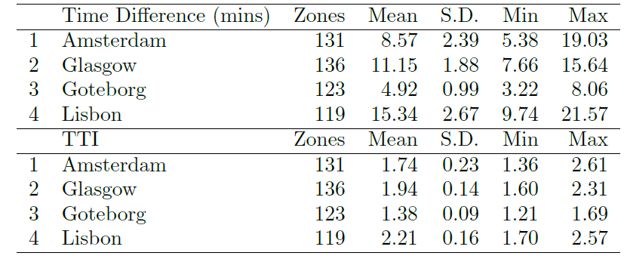
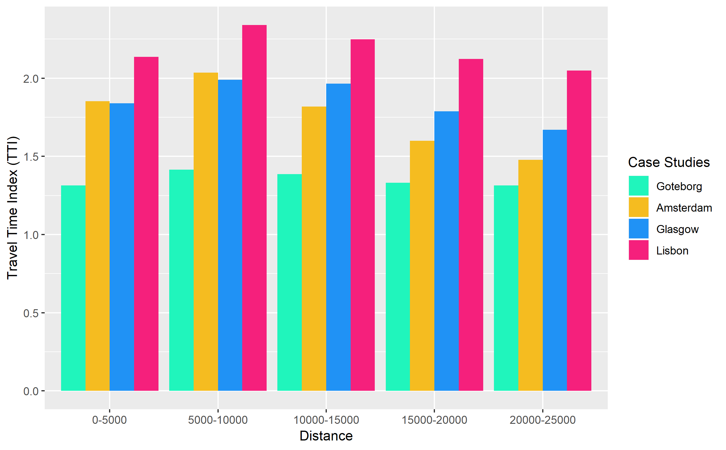
Results: comparing cities

Slide 12
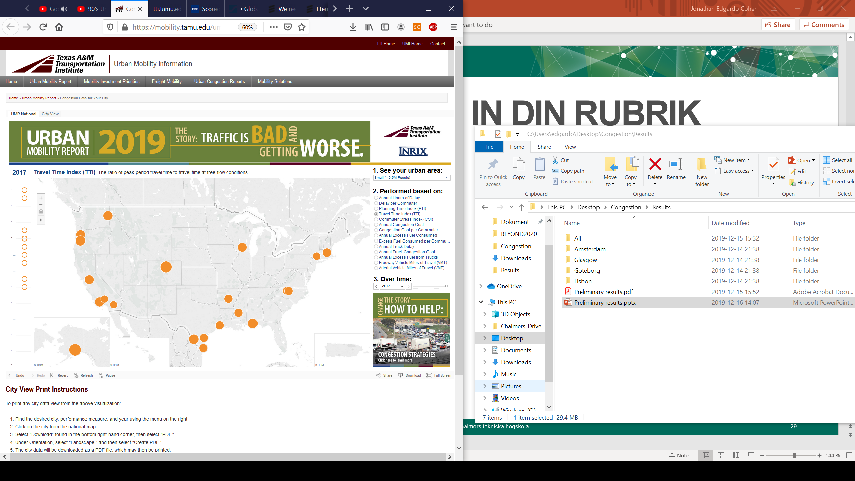
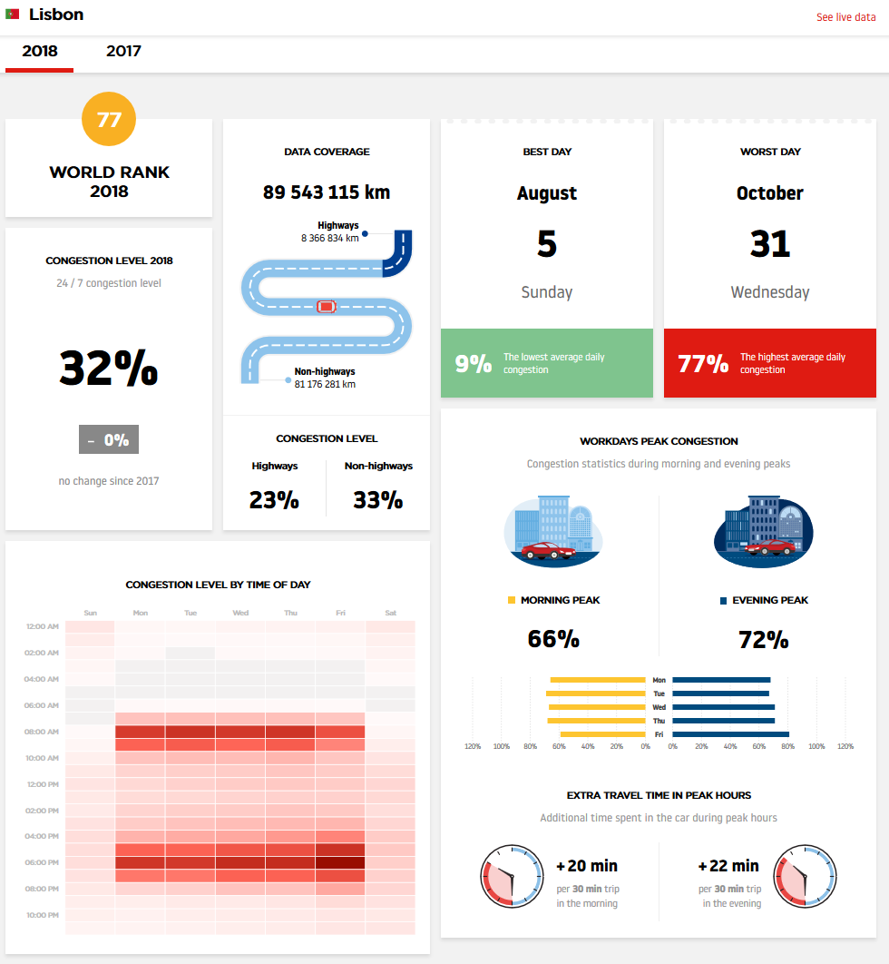
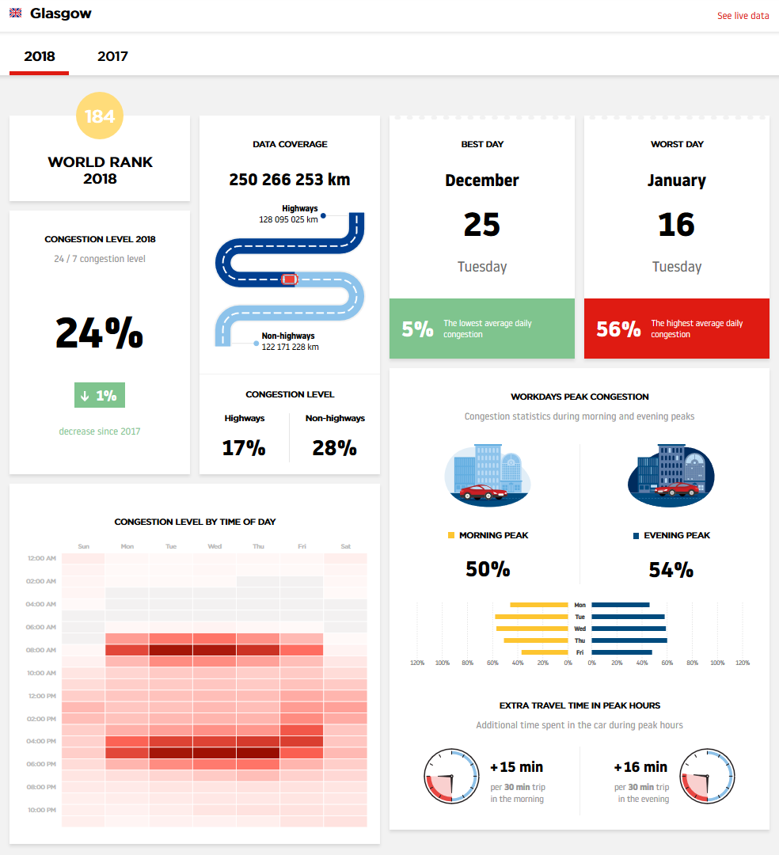
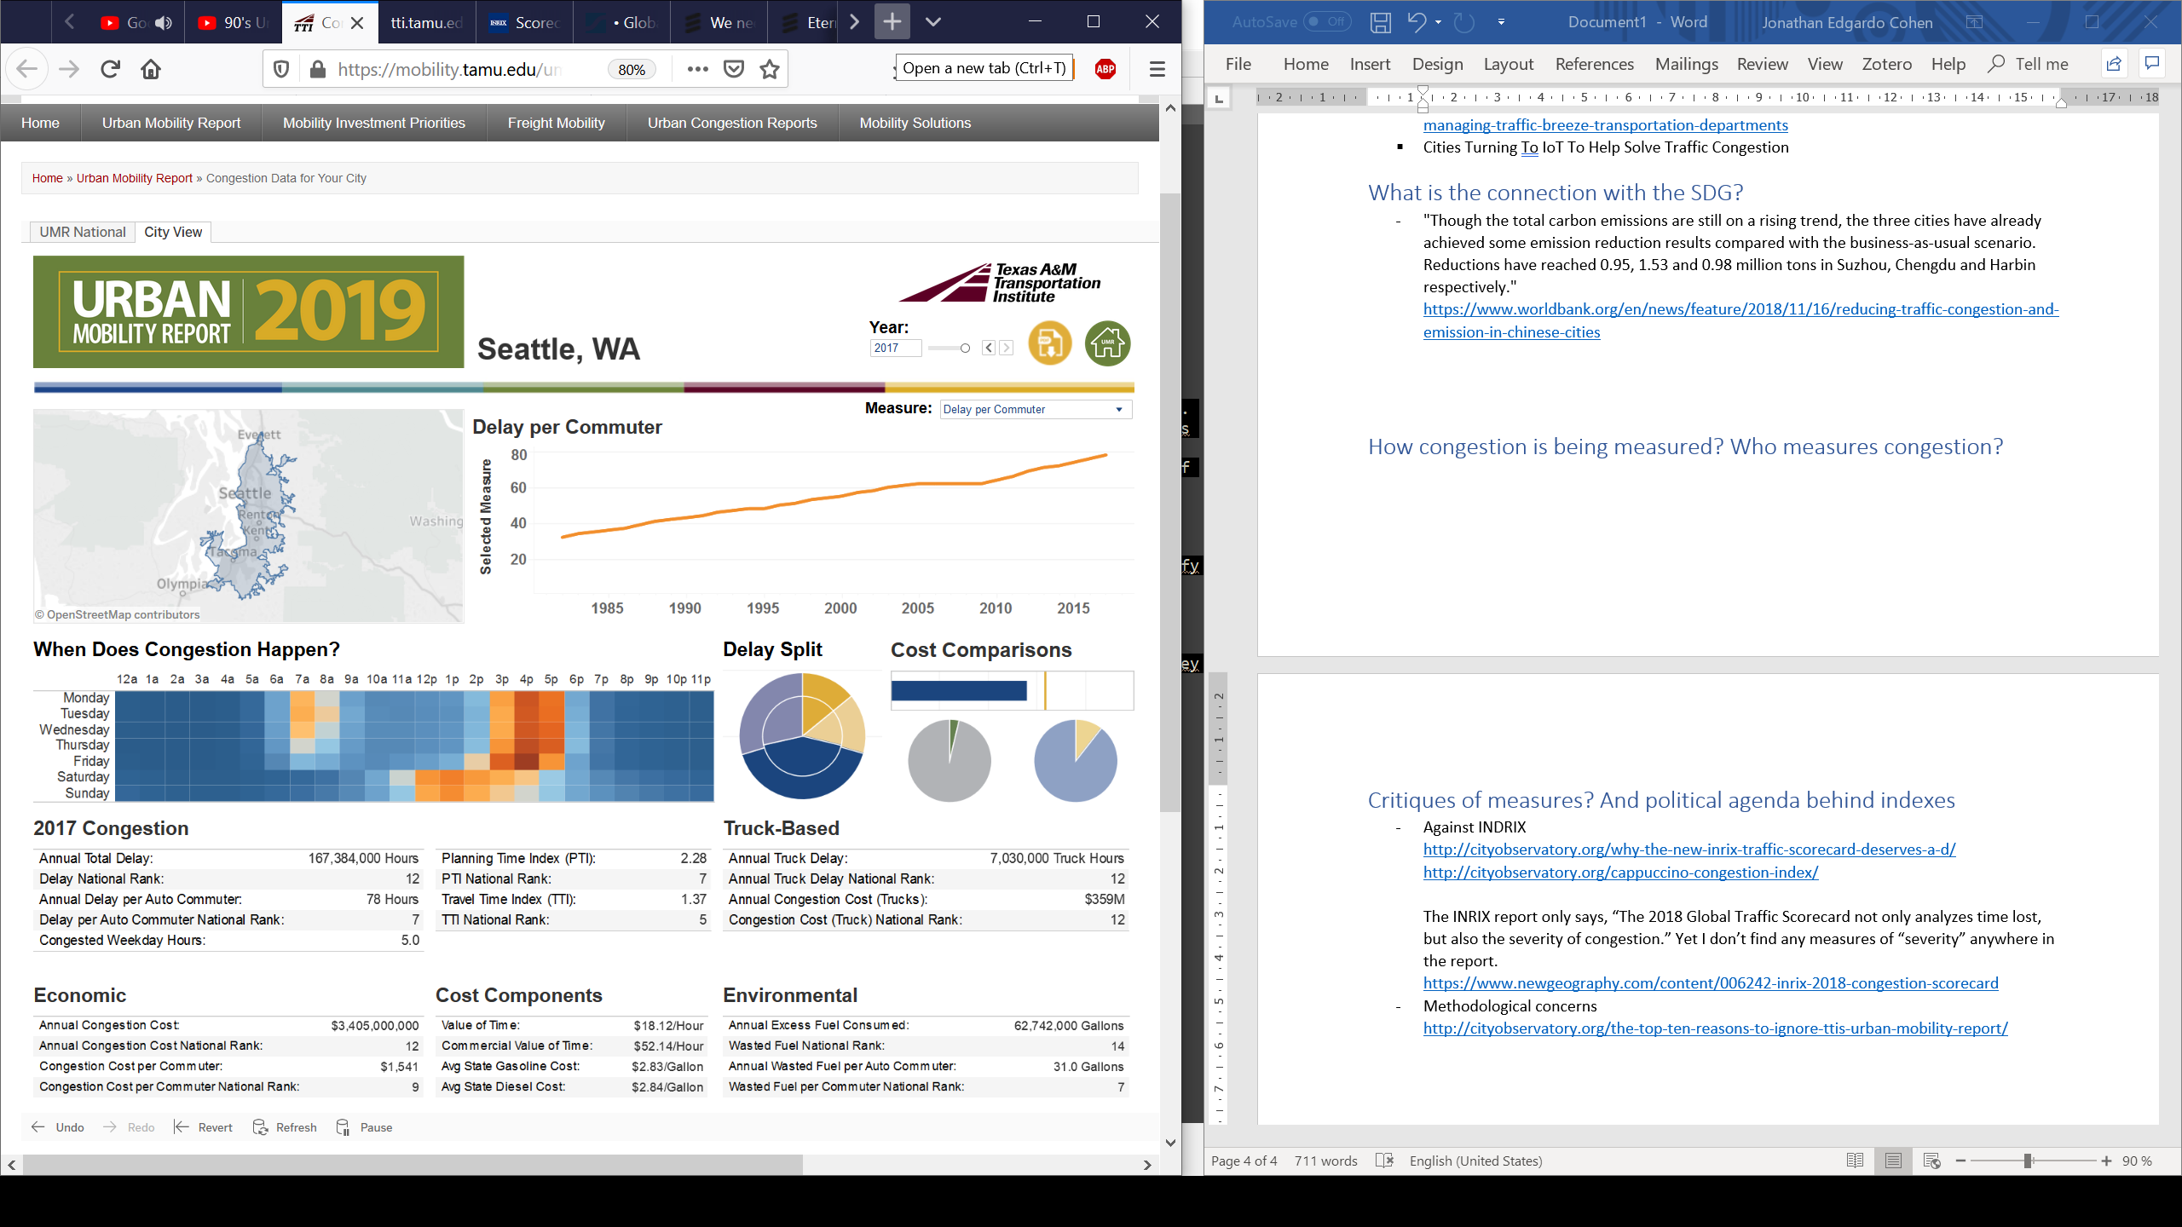
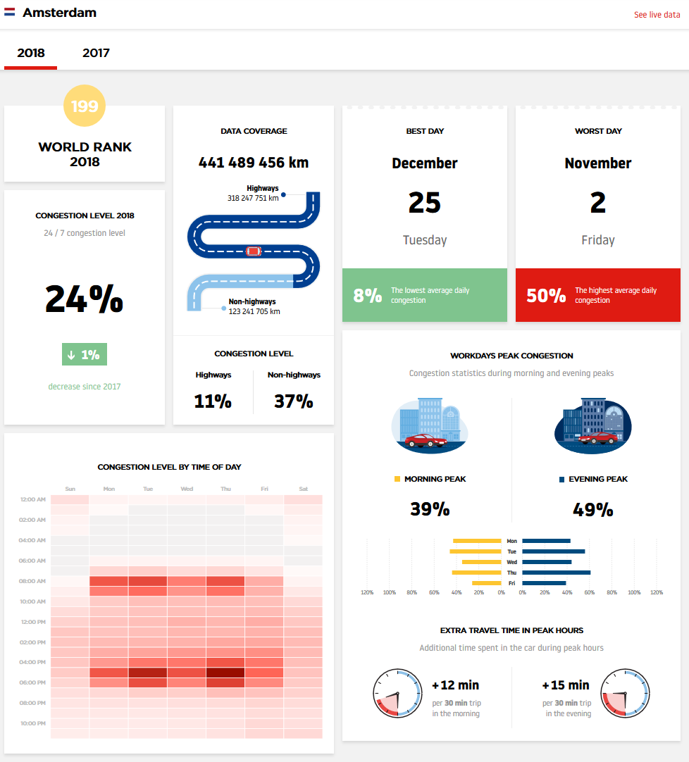
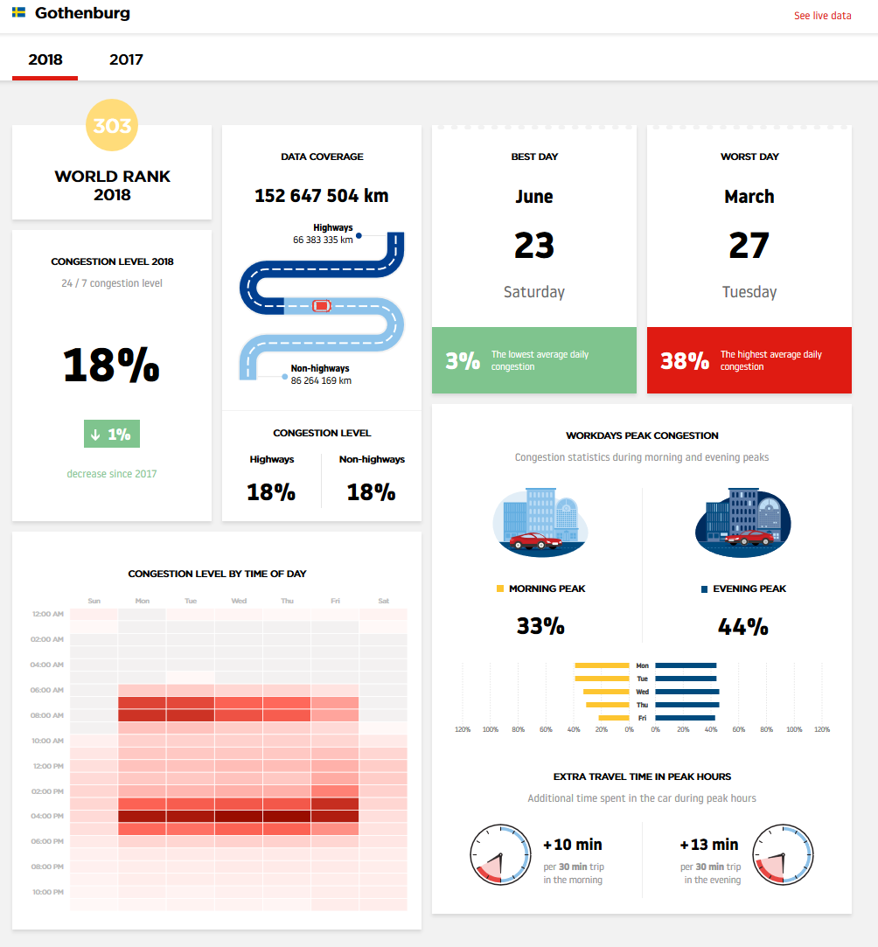
Validation
http://inrix.com/scorecard/
https://www.tomtom.com/en_gb/traffic-index/ranking
Notes:
Make smaller and put our char to the left

Slide 13
Limitations
No control over the service (Google) costs, availability or standards
Only car movements are considered
Assumes equal importance of every trip
Future Work
Test other traffic provider services such as HERE
Extend it to other transportation modes
Weight the KPIs with OD Matrix (travel demand)
Use of other geographical boundaries (with socio-eco data)
Extend the method to evaluate regional or national mobility

Slide 14

Thank for listening
Contact information
Cohen, Jonathan: jonathan.cohen@chalmers.se
Gil, Jorge: jorge.gil@chalmers.se

